Slide 1
2 Measures of location and spread pg. 5
Statistics

Slide 2
Statistics
Quick review
$$mean=\frac{\text{∑}\text{x}\text{​}}{n}$$
The median is the middle value of a data set when it is arranged in ascending or descending order. If there's an even number of data points, the median is the average of the two middle numbers.
{1, 3, 5, 7, 9, 11}
The mode is the most repeated value.
The range is obtained using maximum value – minimum value

Slide 3
Statistics
Quick review
the sum of all data values
$$mean=\frac{\text{∑}\text{x}\text{​}}{n}$$
the number of data values.
The median is the middle value of a data set when it is arranged in ascending or descending order. If there's an even number of data points, the median is the average of the two middle numbers.
{1, 3, 5, 7, 9, 11}
The mode is the most repeated value.
The range is obtained using maximum value – minimum value

Slide 4
2 types of data
Statistics

Slide 5
Statistics

Slide 6
Statistics
{39,39,39,40,40,40,40,40,40,40,40,40,40,40,40,40,40,40,40,40,41,…..}

Slide 7
Statistics
>> Page 7.
{39,39,39,40,40,40,40,40,40,40,40,40,40,40,40,40,40,40,40,40,41,…..}

Slide 8
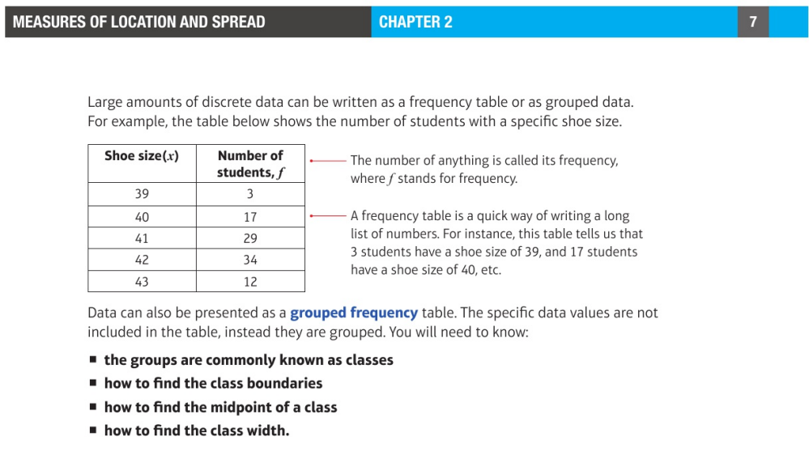
Statistics
Class Boundaries: These are the values halfway between the upper limit of one class and the lower limit of the next class.
Notes:
Classes are intervals in which data is grouped

Slide 9
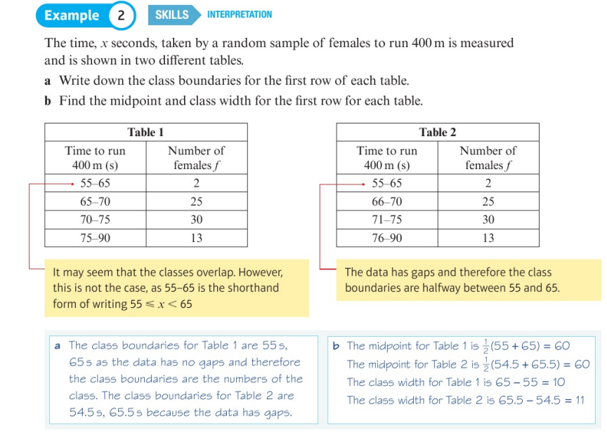
Statistics
Class Boundaries: These are the values halfway between the upper limit of one class and the lower limit of the next class.
Notes:
Classes are intervals in which data is grouped

Slide 10
Statistics
Combining means
$$x̄=\frac{n_{1}^{}{x̄}_{1}^{}+n_{2}^{}{x̄}_{2}^{}\text{​}}{n_{1}^{}+n_{2}^{}}$$
$x̄=\frac{\sum{xf}\text{​}}{\sum{f}}$ , wherein x = data values, f = frequency

Slide 11
2 Measures of location and spread pg. 5
Statistics

Slide 12
2 Measures of location and spread pg. 5
Statistics

